Slide 1
Unit 3
Part-2

Slide 2
Structure and function of respiratory system of insects
Similar to aerobic animals, insects must obtain oxygen from their environment and eliminate carbon dioxide respired by their cells.
This is gas exchange through series of gas filled tubes providing surface area for gaseous exchange (Respiration strictly refers to oxygen consuming, cellular metabolic processes).
Air is supplied directly to the tissue and no haemolymph (blood) is involved in the respiratory role.

Slide 3
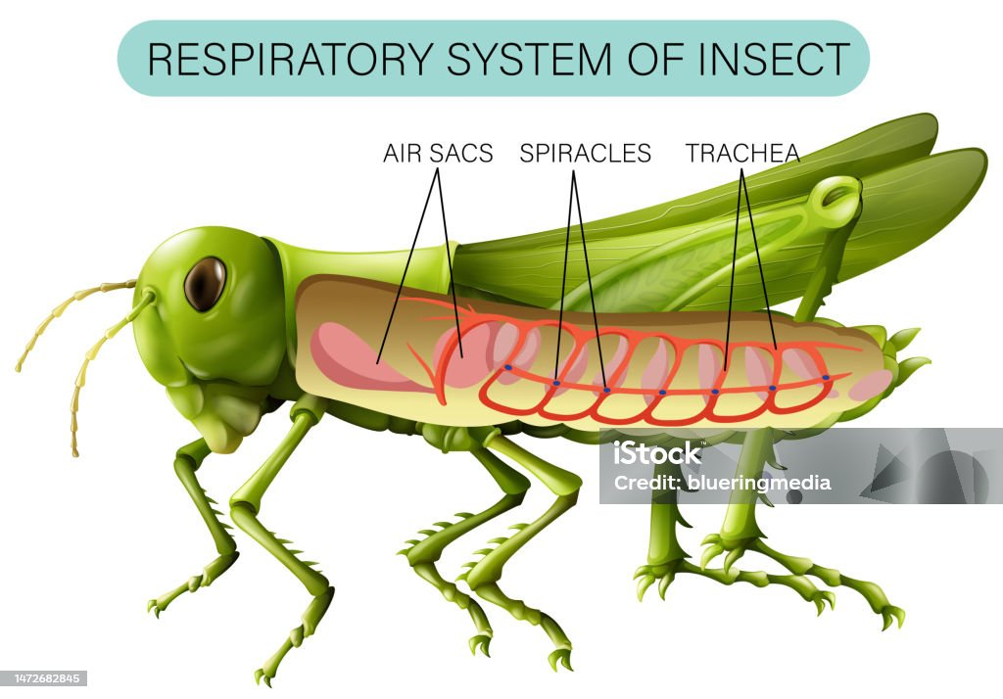
Continue…
. Air usually enters the tracheae via spiracular openings positioned laterally on the body. No insect has more than ten pairs (two thoracic and eight abdominal).

Slide 4
ORGANS OF RESPIRATION
Spiracles have a chamber or atrium with a opening and closing mechanism called valve.
This regulates air passage and minimise water loss. Each spiracle is set in a sclerotized cuticular plate called a peritreme.
Tracheae are invaginations of the epidermis and thus their lining is continuous with the body cuticle.
The ringed appearance of the tracheae is due to the spiral ridges called taenidia. This allows the tracheae to be flexible but resist compression.
The cuticular linings of the tracheae are shed when the insect moults, but not the linings of tracheoles.

Slide 5
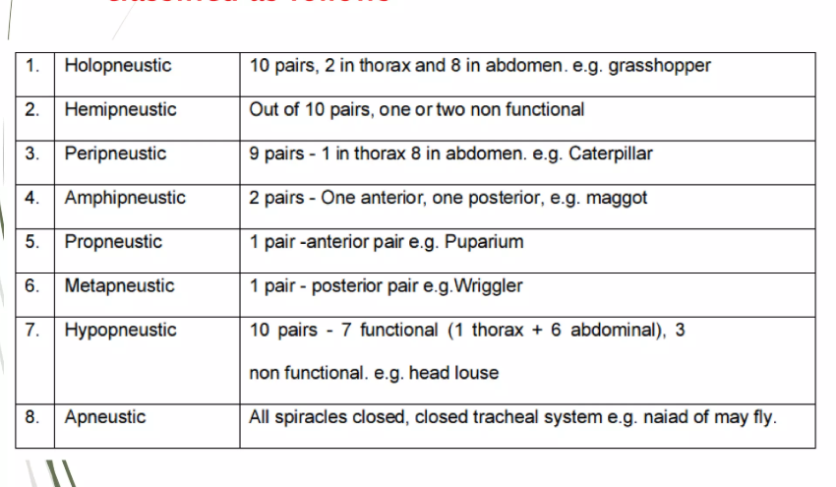
Classification on respiratory system based on location and functional spiracles

Slide 6
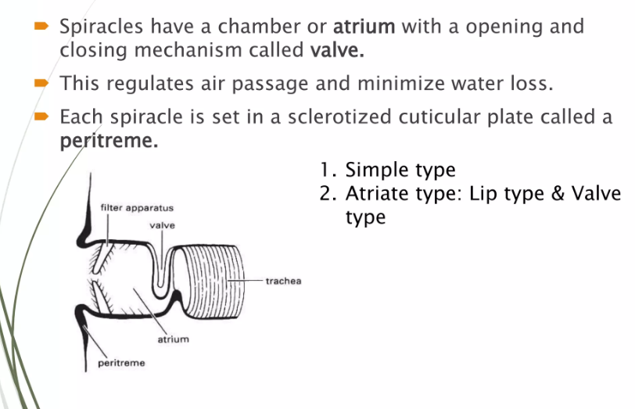

Slide 7
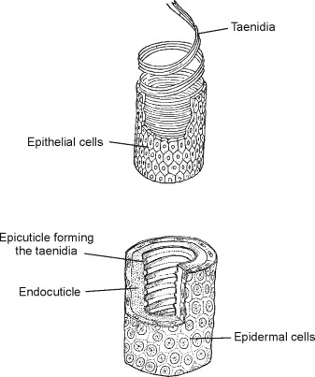
Tracheoles are less than 1 µm in diameter; the end blindly and closely contact the respiring tissues. Taenidia and waxlayer is absent.
Gaseous exchange occurs across tracheoles. There are four tracheal trunks viz., lateral, dorsal, ventral and visceral, helping in the passage of air.
In the trachea, thin walled-collapsable sac like dilations are present, called as airsacs where taenidia is absent.
Airsacs acts as oxygen reservoir. Provide buoyancy to flying and aquatic insects. Provide space for growing organs. Acts as sound resonator and heat insulators.

Slide 8
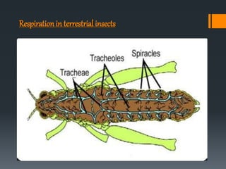
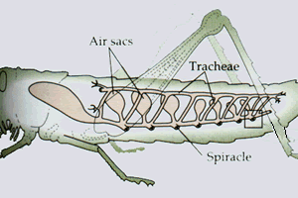

Slide 9
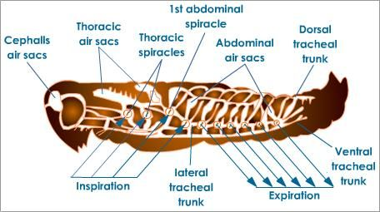

Slide 10
Mechanism of respiration
Oxygen enters the spiracle and passes through the length of the tracheae to the tracheoles and into the target cells by diffusion along a concentration gradient, from high in the external air to low in the tissue.
Where as the net movement of oxygen molecules in the tracheal system is inwards (Inspiration), the net movement of CO2 and water vapour molecules is outwards, (Expiration)

Slide 11
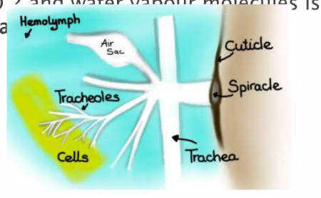

Slide 12
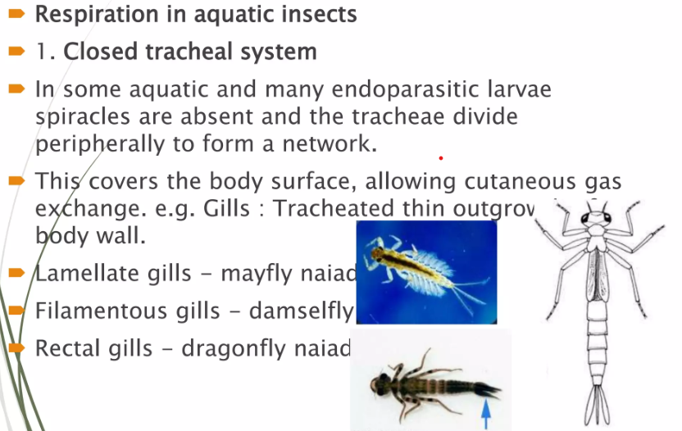
Types of respiration

Slide 13
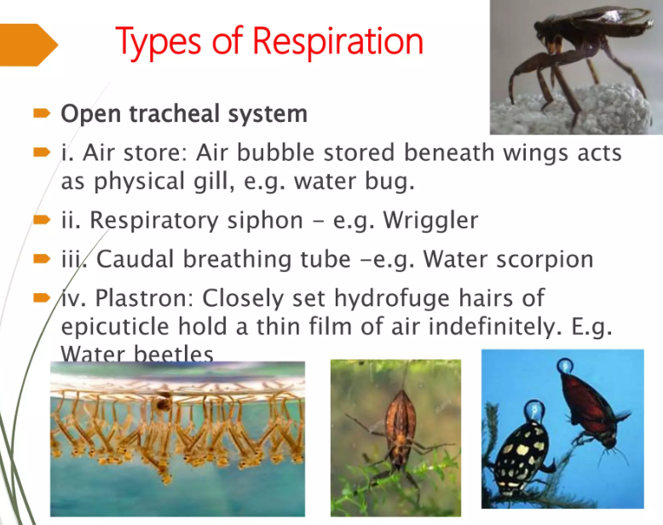

Slide 14
Secretory (Endocrine system)
The endocrine organ and hormones together referred as endocrine system.
Endocrine organs produce hormone in blood which travels in blood to various organs of the body coordinating their activities.
A hormone is a chemical signal sent from cells in one part of an organism to cells in another part (or parts) of the same individual. They are often regarded as chemical messengers.
Although typically produced in very small quantities, hormones may cause profound changes in their target cells. Their effect may be stimulatory or inhibitory. In some cases, a single hormone may have multiple targets and cause different effects in each target.

Slide 15
Endocrine Organ
The endocrine system are of two types:
Neurosecretory Cells ( within the CNS)
The specialized endocrine glands
Corpora cardiaca
Corpora allata.
Prothoracic glands

Slide 16
Continue…
These hormone-secreting structures form an endocrine system that helps maintain homeostasis, coordinate behavior, and regulate growth, development, and other physiological activities.

Slide 17
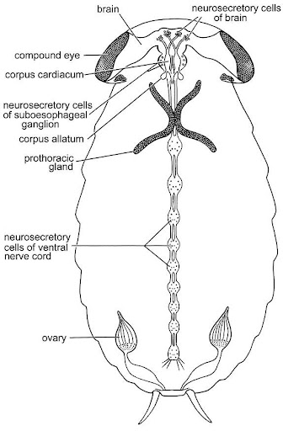

Slide 18
Neurosecretory cells
Neurosecretory cells —The neurosecretory cells are found in clusters, both medially and laterally in the insect’s brain. Axons from these cells can be traced along tiny nerves that run to the corpora cardiaca and corpora allata. Functionally, they serve as a link between the nervous system and the endocrine system.
Neurosecretory cells in the brain regulate activity of the corpora allata — stimulating them to produce JH during larval or nymphal instars, inhibiting them during the transition to adulthood, and reactivating them once the adult is ready for reproduction.

Slide 19
The cells produce and secrete brain hormone, a low-molecular-weight peptide that appears to be the same as (or very similar to) prothoracicotropic hormone (PTTH) manufactured by the corpora cardiaca.

Slide 20
Prothoracic gland
In insects, the largest and most obvious endocrine glands are found in the prothorax, just behind the head.
These prothoracic glands manufacture ecdysteroids, a group of closely-related steroid hormones (including ecdysone) that stimulate synthesis of chitin and protein in epidermal cells and trigger a cascade of physiological events that culminates in molting. For this reason, the ecdysteroids are often called “molting hormones”. Once an insect reaches the adult stage, its prothoracic glands atrophy (wither away) and it will never molt again.

Slide 21
Corpora Cardiaca
Prothoracic glands produce and release ecdysteroids only after they have been stimulated by another chemical messenger, prothoracicotropic hormone (PTTH for short). This compound is a peptide hormone secreted by the corpora cardiaca, a pair of neurohemal organs located on the walls of the aorta just behind the brain. The corpora cardiaca release their store of PTTH only after they receive a signal from neurosecretory cells in the brain. In a sense, they act as signal amplifiers — sending out a big pulse of hormone to the body in response to a small message from the brain.

Slide 22
Corpora allata
The corpora allata, another pair of neurohemal organs, lie just behind the corpora cardiaca. They manufacture juvenile hormone (JH for short), a compound that inhibits development of adult characteristics during the immature stages and promotes sexual maturity during the adult stage.

Slide 23
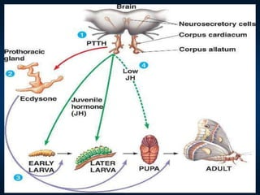

Slide 24
Reproductive system in insects
Lecture plan

Slide 25
In insects male and female sexes are mostly separate.
Sexual dimorphism is common where the male differ from the female morphologically. e.g. bee, mosquito and cockroach.
The other types are Gynandromorph: (Sexual mosaic) Abnormal individual with secondary sexual characters of both male and female. e.g. mutant Drosophila.
Hermaphrodite: Male and female gonads are in one organism. e.g. Cottony cushion scale.

Slide 26
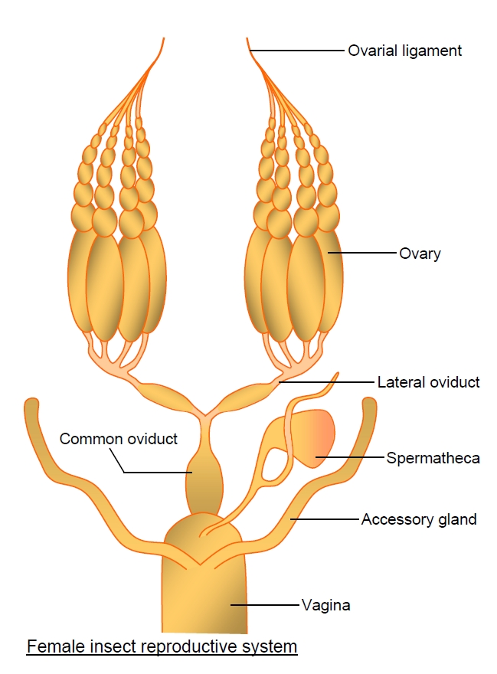
The main function of the female reproductive system are egg production and storage of male's spermatozoa until the eggs are ready to be fertilized. The basic components of the female system are paired ovaries, which empty their mature oocytes (eggs) via the calyces (Calyx) into the lateral oviduct which unite to form the common (median) oviduct. The gonopore (opening) of the common oviduct is usually concealed in an inflection of the body wall that typically forms a cavity, the genital chamber.
This chamber serves as a capulatory pouch during mating and thus is often known as the bursa copulatrix.

Slide 27
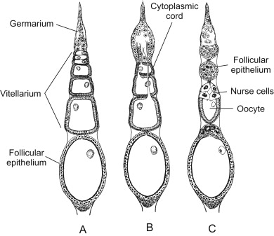
Two types of ectodermal glands open into the genital chamber.
The first is the spermatheca which stores spermatoza until they are needed for egg fertilization.
The second type of ectodermal gland, known collectively as accessory glands, opens more posteriorly in the genital chamber.
Each ovary is composed of a cluster of egg or ovarian tubes, the ovarioles, each consisting of a terminal filament, a germarium (in which mitosis gives rise to primary oocytes), a vitellarium (in which oocytes grow by deposition of yolk in a process known as vitellogenesis) and a pedicel.

Slide 28
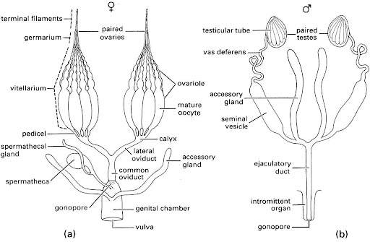

Slide 29
MALE REPRODUCTIVE SYSTEM
The main functions of the male reproductive system are the production and storage of spermatozoa and their transport in a viable state to the reproductive tract of the female.
Morphologically, the male tract consists of paired testes, each containing a series of testicular tubes or follicles (in which spermatozoa are produced) which open separately into the mesodermally derived sperm duct or Vas deferens which expands posteriorly to form a sperm storage organ or seminal vesicle.
Tubular paired accessory glands are formed as diverticula of the vasa deferentia. Sometimes the vasa deferentia themselves are glandular and fulfil the functions of accessory glands. The paired vasa deferentia unite where they lead into the ectodermally derived ejaculatory duct (the tube that transports the semen or the sperm to the gonopore).

Slide 30
Accessory glands are 1-3 pair, either mesodermal of ectodermal in origin and associated with vasa deferentia or ejaculatory duct. Its function is to produce seminal fluid and spermatophores (sperm containing capsule).

Slide 31
PHYSIOLOGY OF REPRODUCTION
1. Spermatogenesis: (occurs inside sperm tube)
2. Oogenesis : (occurs inside egg tube)
3. Sperm transfer
(i) Intragenital: Common method, through, aedeagus via vaginal orifice into female genital passage.
(ii) Haemocoelous: Sperms transfered into the body cavity e.g. Bed bug.
(iii)External: Spermatophores are ejected out into open place by male, while female walk over it and gets inseminated e.g. Silver fish.

Slide 32
Continue….
4. Fertilization: Sperm entre into egg to produce morphogenesis. Egg nucleous divides meiotically into female gamete nucleus and polar body. Then the fertilization occurs by the fusion of male and female gamete nuclei.

Slide 33
TYPES OF REPRODUCTION
1. OVIPARITY
Majority of female insects are oviparous that is, they lay eggs. Embryonic development occurs after oviposition by utilizing the yolk, e.g. Head louse moths.
2. VIVIPARITY
Unlike oviparous, here initiation of egg development take place within the mother. The life cycle is shortened by retention of eggs and even developing young within the mother. Four main types of viviparity are observed in different insect groups.
i. OVOVIVIPARITY
Fertilized eggs containing yolk are incubated inside the reproductive tract of the female and hatching of egg occur just prior to or soon after oviposition e.g. Thysanoptera, some cockroaches, few beetles, and some flies-(fleshfly). Fecundity of this group is low.

Slide 34
Continue….
ii. PESEUDOPLACENTAL VIVIPARITY
A yolk-deficient egg develops in the genital tract of the female. The mother provides a special placenta-like tissue, through which nutrients are transferred to developing embryos. There is no oral feeding and larvae are laid upon hatching. e.g. aphids, some earwigs, psocids and polytenid bugs.
ii. HAEMOCOELOUS VIVIPARITY
Embryos develops free in the female's haemolymph with nutrients taken up by osmosis. This form of internal parasitism occurs only in sterpsiptera and some gall midges.
v. ADENOTROPHIC VIVIPARITY
Poorly developed larva hatches and feeds orally from accessory (milk) gland secretion within the uterus of the mother's reproductive system. The full grown larva is deposited and pupariates immediately (eg) tsetse flies, louse or wallaby flies, bat flies.

Slide 35
3. PARTHENOGENESIS
Reproduction without fertilization is called parthenogenesis.
4.POLYEMBRYONY
This form of asexual reproduction involves the production of two or more embryos from one egg by subdivision. Mostly observed in parasitic insects (e.g. platygaster). Nutrition for a large number of developing embryo cannot be supplied by the original egg and is acquired from the host's haemolmph through a specialized enveloping membrane called trophamnion.
5.PAEDOGENESIS
Some insect cut short their life cycles by loss of adult and pupal stages. In this precocious stage gonads develop and give birth to young one by parthenogenesis.
i. Larval paedogenesis - e.g. gall midges
ii. Pupal paedogenesis - eg Miaster sp.

